Slide 1
Steady-State Analysis
  Steady-state analysis
    System type with respect to reference inputs
      Continuous-time systems (review)
        Type 0 system, position error constant
        Type 1 system, velocity error constant
      Discrete-time systems
        Type 0 system, position error constant
        Type 1 system, velocity error constant
    System type with respect to disturbances

Slide 2








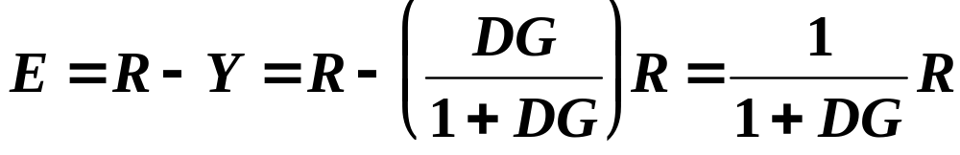
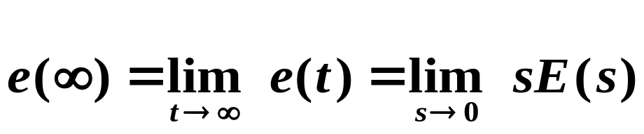
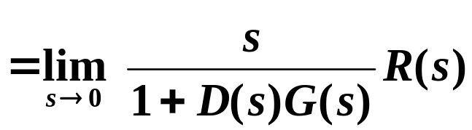
Steady-State Analysis
Σ
Error: e = r - y
Continuous-Time Systems
If a system is stable (except one simple pole at s = 0), the (continuous-time) final value theorem states:

Slide 3
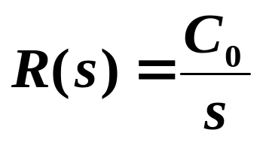


System Type for Continuous-Time Systems
We are often interested in what type of inputs a system can follow with finite error.
Type 0:
System can follow a step (0th-order polynomial) input with finite (nonzero) error.
Type 1:
System can follow a ramp (1st-order polynomial) input with finite (nonzero) error.
Type :
System can follow an -order polynomial input with finite (nonzero) error. A type system can follow polynomials of order < with zero steady-state error, and it cannot follow polynomials of order > .

Slide 4
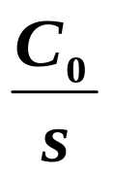
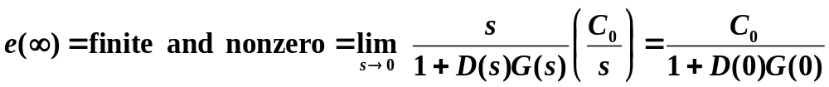
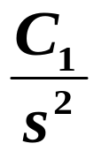
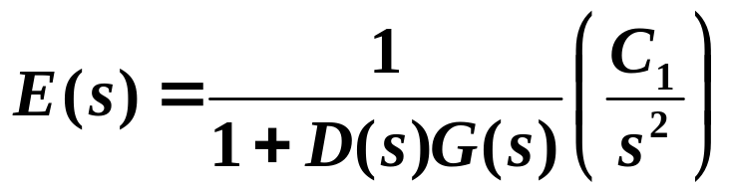
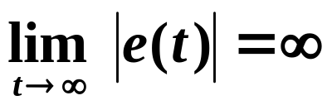
Type 0 System with respect to R(s)
If R(s) = step =
If R(s) = ramp =

Slide 5
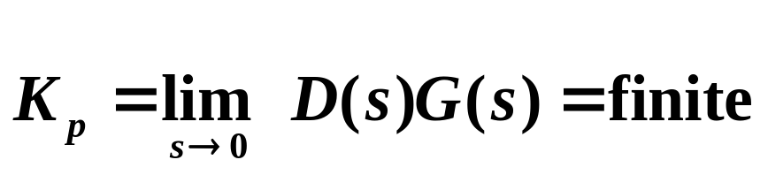
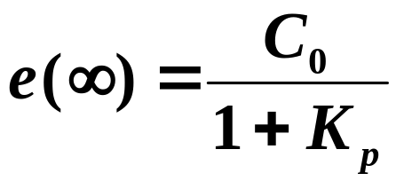
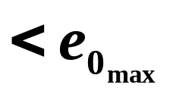
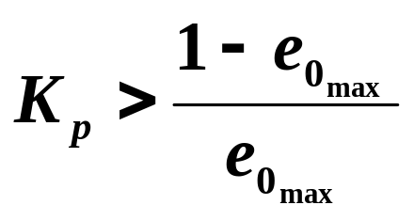
Position Error Constant for a Type 0 Continuous System
With respect to a reference input r(t) = C₀ 1(t) ,
If want to design D(s) such that the steady-state error to a unit step :

Slide 6
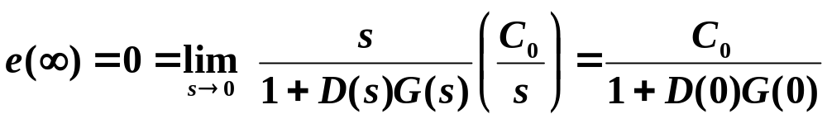
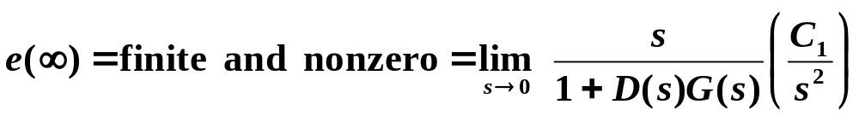
Type 1 System with respect to R(s)
If R(s) = step =
D(s)G(s) must have a pole at s = 0
If R(s) = ramp =

Slide 7
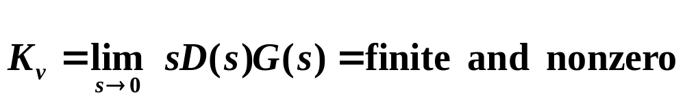
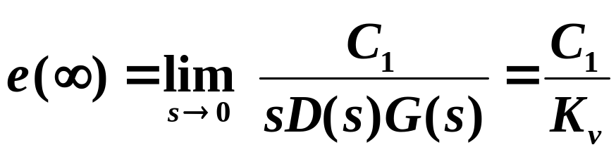
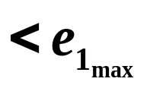
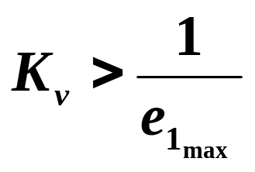
Velocity Error Constant for a Type 1 Continuous System
With respect to a reference input r(t) = C₁ t 1(t) ,
If want to design D(s) such that the steady-state error to a unit ramp :

Slide 8






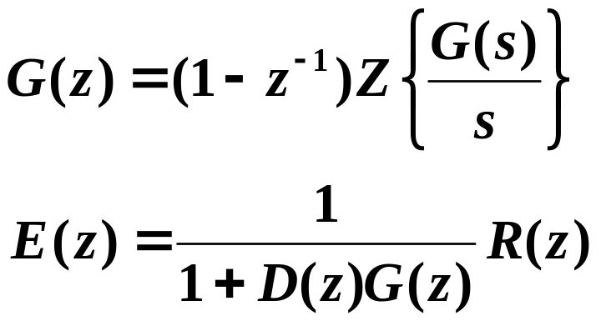
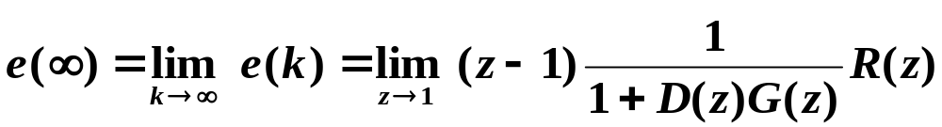
System Type for Discrete-Time Systems
Σ
If a system is stable (except one simple pole at z = 1), the (discrete-time) final value theorem states:

Slide 9
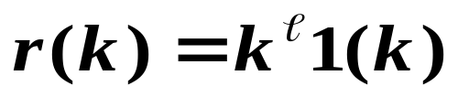
A discrete-time system is:
Type 0:
System can follow a discrete step input 1(k) with finite (nonzero) error.
Type :
System can follow with finite (nonzero) error.

Slide 10
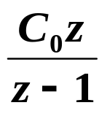

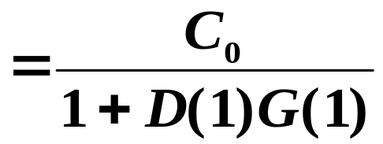
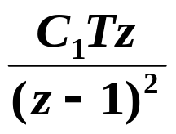
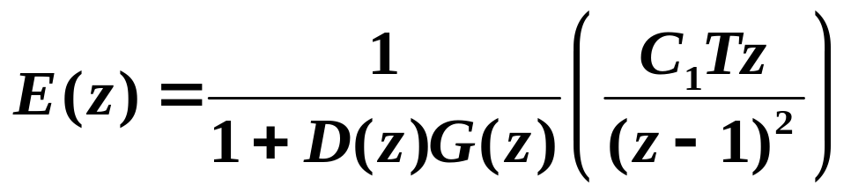
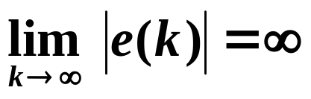
Type 0 System with respect to R(z)
If R(z) = step =
D(1)G(1) must be finite.
If R(z) = ramp =
Infinite error in tracking ramp.

Slide 11
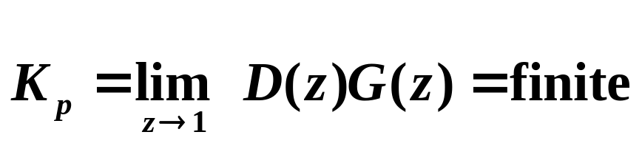
Position Error Constant for a Type 0 Discrete System
With respect to a reference input r(k) = C₀ 1(k) ,
If want to design D(z) such that the steady-state error to a unit step :

Slide 12
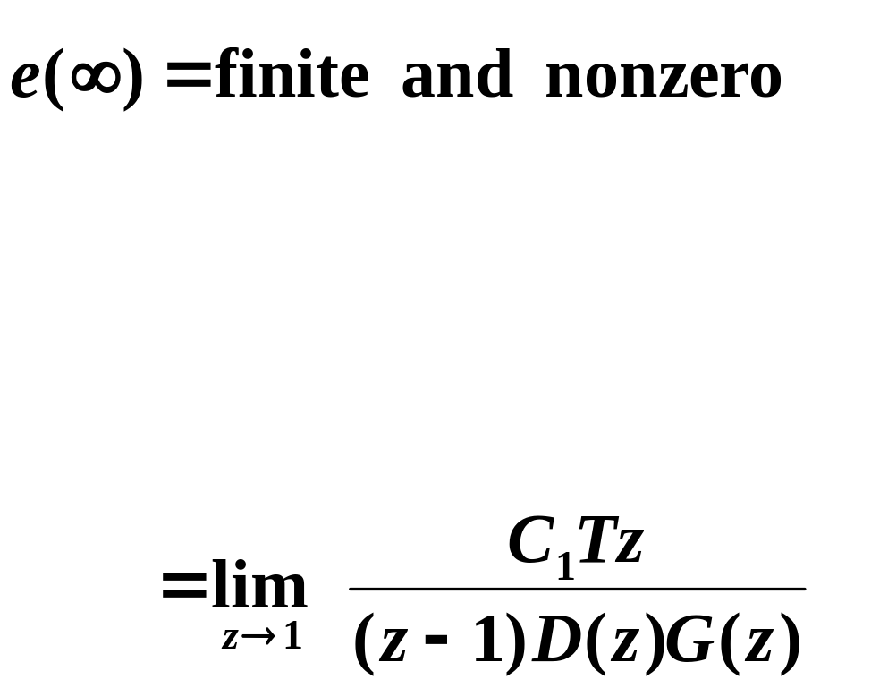
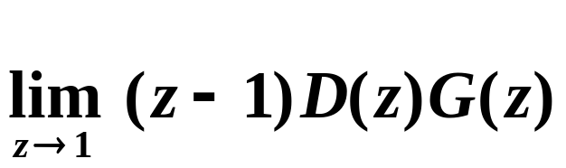
Type 1 System with respect to R(z)
If R(z) = ramp =
must be finite and nonzero

Slide 13
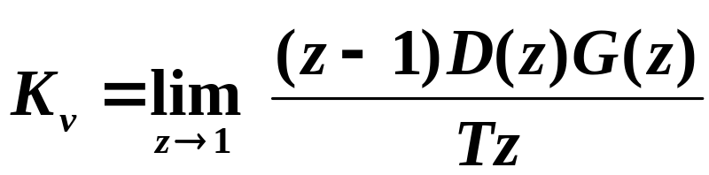
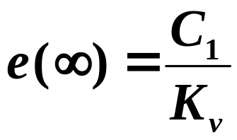
Velocity Error Constant for a Type 1 Discrete System
With respect to a reference input r(k) = C₁ k 1(k) ,
If want to design D(z) such that the steady-state error to a unit ramp :

Slide 14
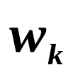

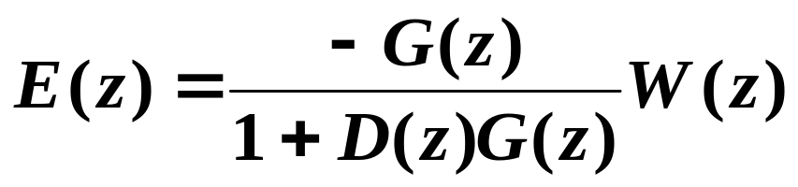
System Type w.r.t. Disturbances
Σ
Σ
Assume to evaluate effects of
If |DG| >>1
Hence, if |D| >>1

